Slide 1
Saving new developers from our battle scars
Jon Skeet (jonskeet@)

Slide 2
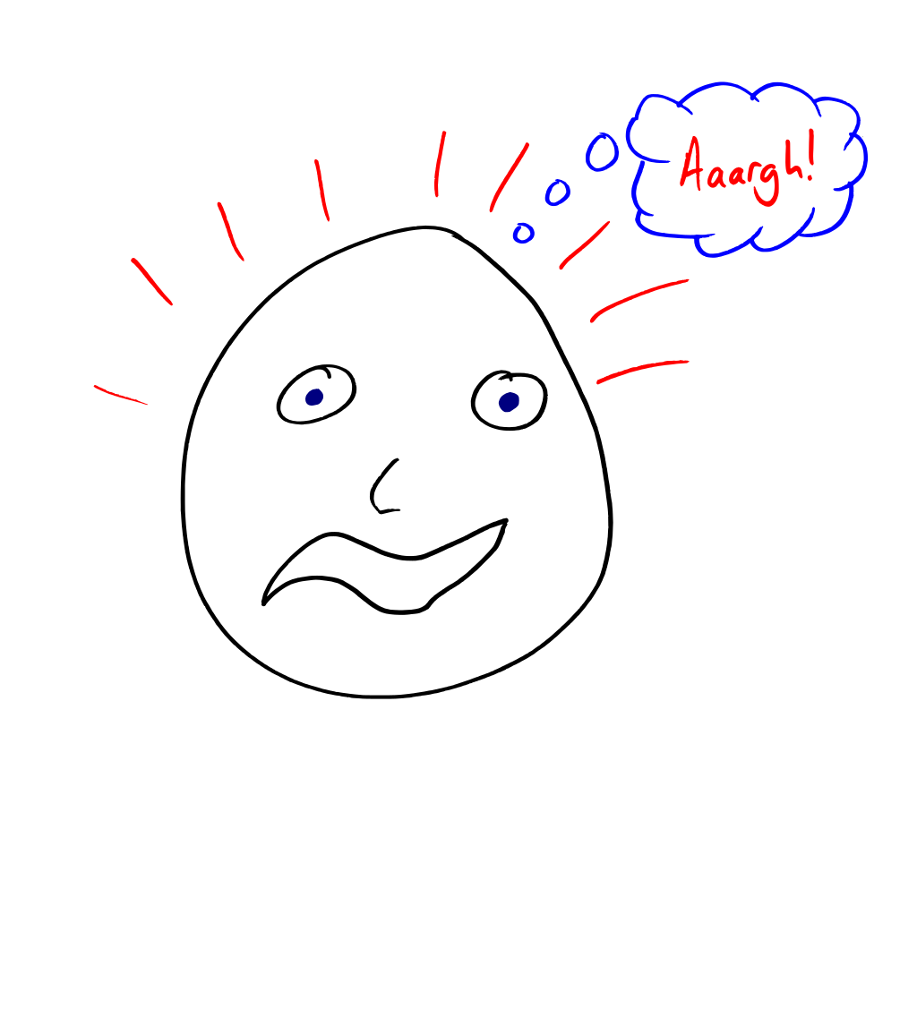
Notes:
Bootstrapping is hard (ref writing C# book)
Let’s make life as easy as possible for newcomers
Somewhat based on Humanity: Epic Fail talk from a while ago.
You probably know all this already – but may have learned it in a different way. (If you remember how you learned, and think it’s better, that’s fine! There’s more than one way of doing it…)

Slide 3
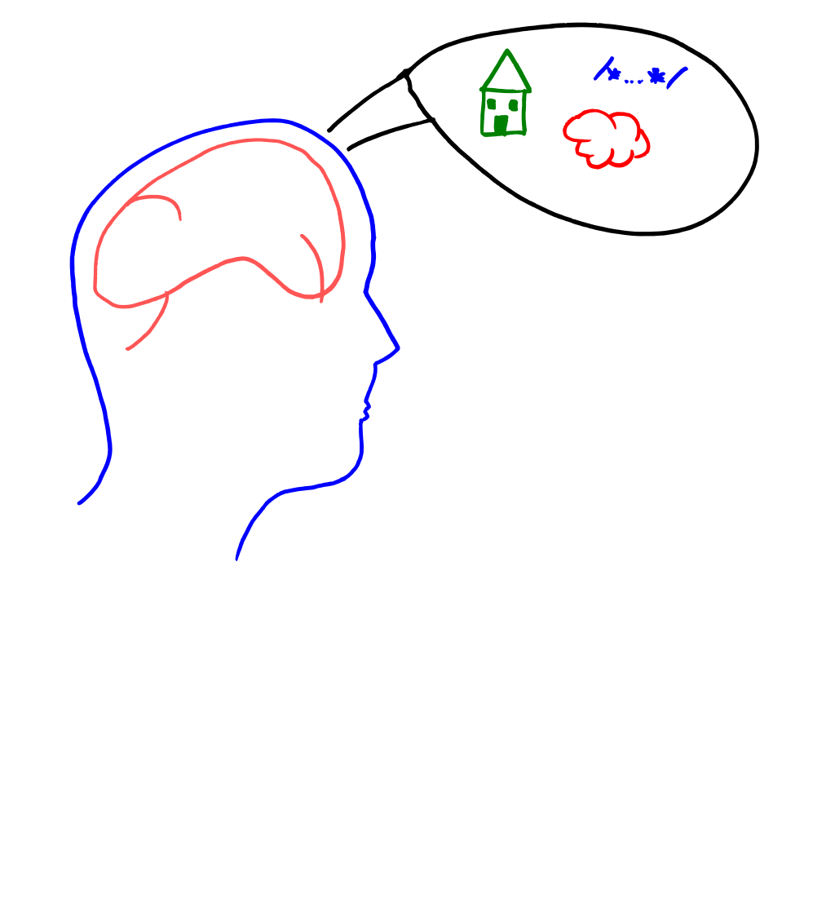
Notes:
We’re trying to create mental models for people.
Express new concepts in terms of ones they already know
Only presenting some examples here – but you can think of more

Slide 4
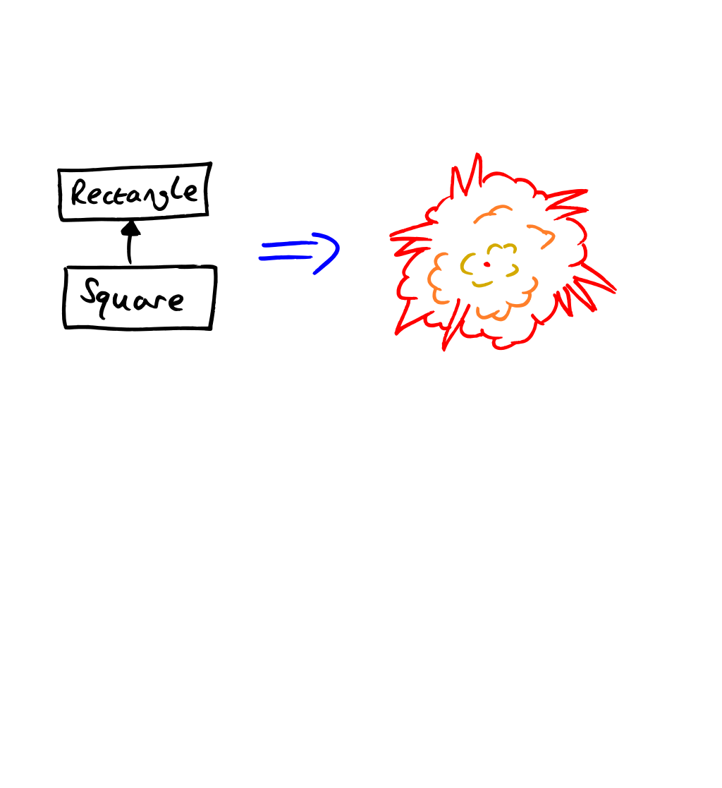
Notes:
Some mental models and shorthands can be harmful:
“Inheritance models is-a relationships”
“Value types go on the stack, reference types go on the heap”
Almost every analogy breaks down if you push it too far

Slide 5
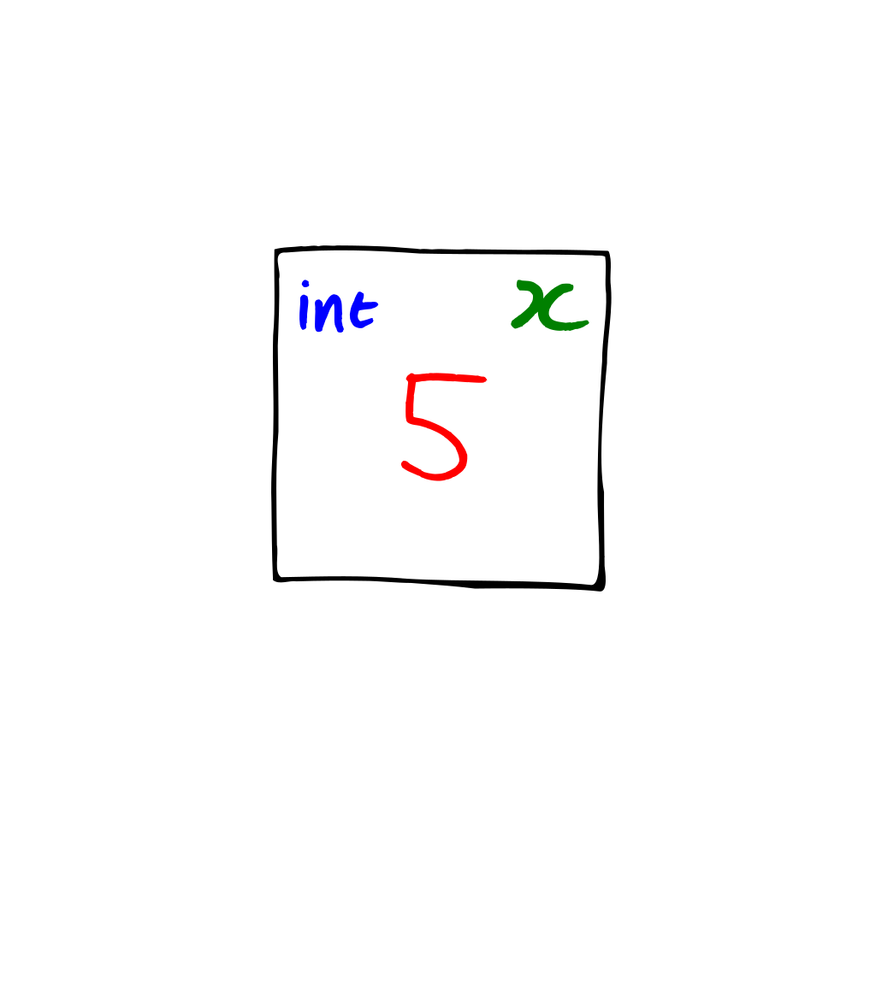
Notes:
First and probably most important mental model for C# and Java: variables, references and objects
Well, after types – they’re almost impossible to bootstrap, but don’t seem to cause as many problems
Often badly explained, but this is a model I’ve found works well… for C# and Java
Other languages may well differ - important lesson
A variable is like a piece of paper. It has:
A type
A name
A value

Slide 6

Notes:
This is an object. In our imaginary world, a house has two pieces of state:
A door colour
A number of windows
I’m not modelling operations here, just state
To clarify, a House object isn’t a picture of a house. It’s a physical house. This becomes important…

Slide 7
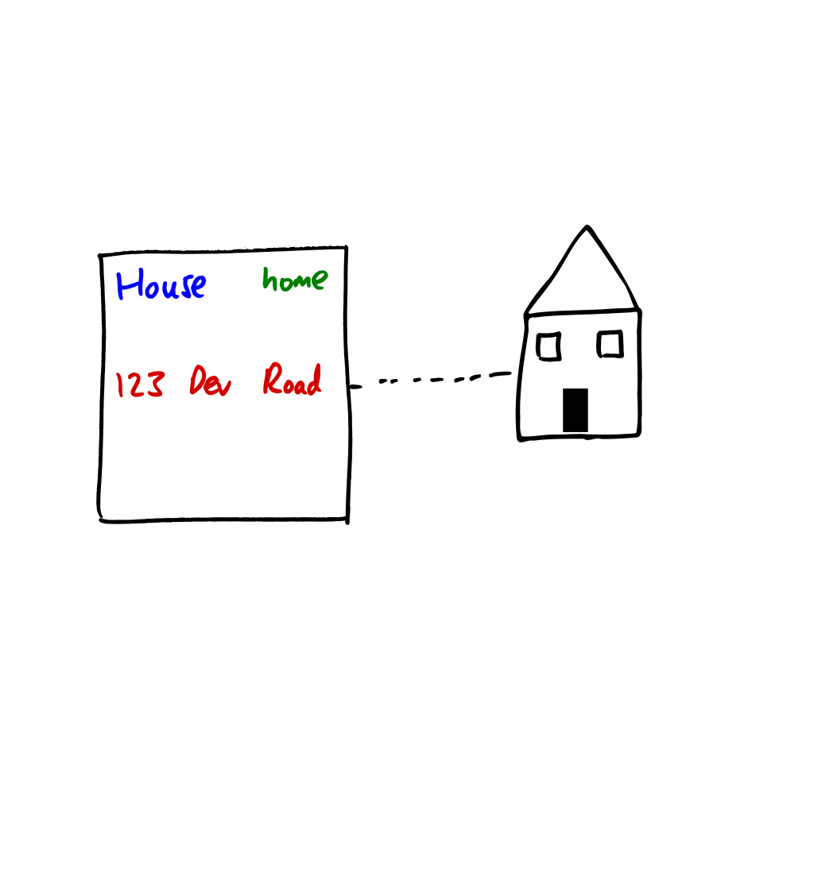
Notes:
Now let’s put things together. We have a variable, and an object.
The link between the two is the value of the variable, the reference.
It’s a way of navigating to the object, just like a street address is.
No, it’s not necessarily a physical memory address. Limitations!

Slide 8
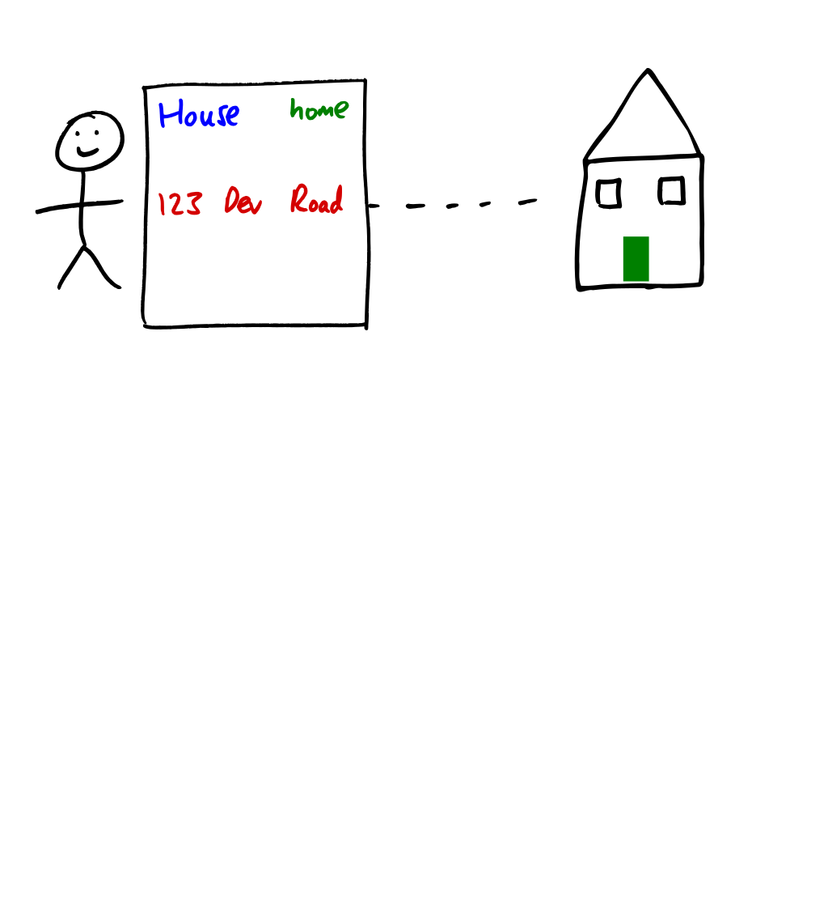
Notes:
Now we can tell a story. This is Jon. He has a piece of paper with his home address on.

Slide 9
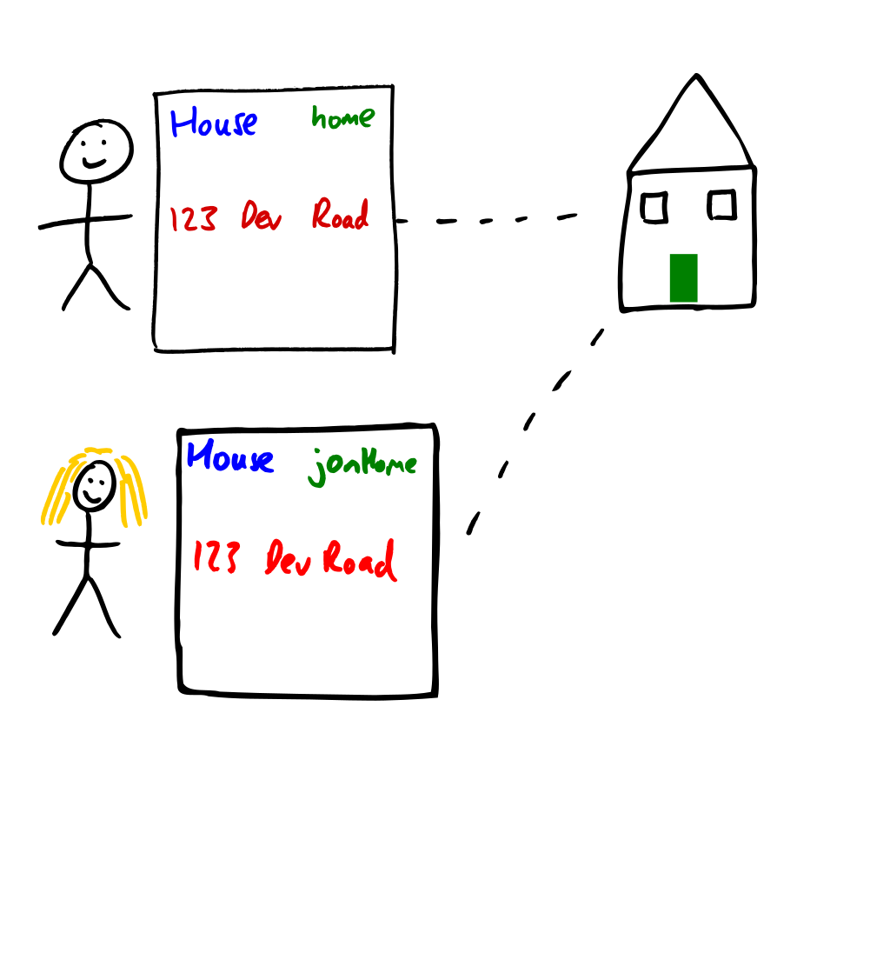
Notes:
Jon gives his friend Cori a copy of the reference.
In code, this might be an assignment or a method call passing home as an argument.

Slide 10
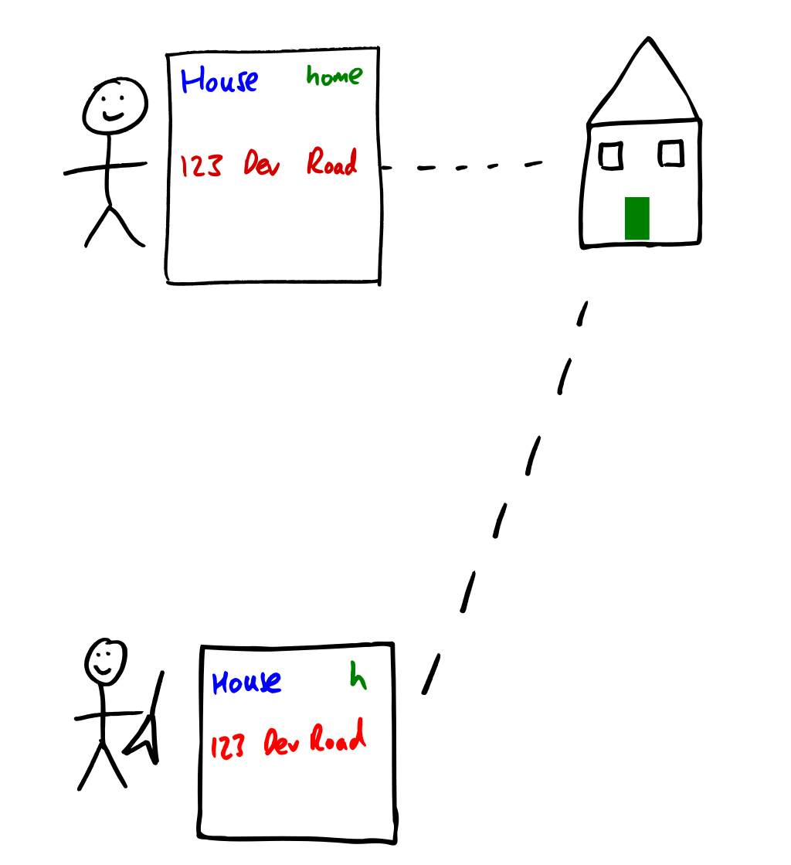
Notes:
Jon gives his friend Dustin (who happens to play the guitar) a copy in a similar way.

Slide 11
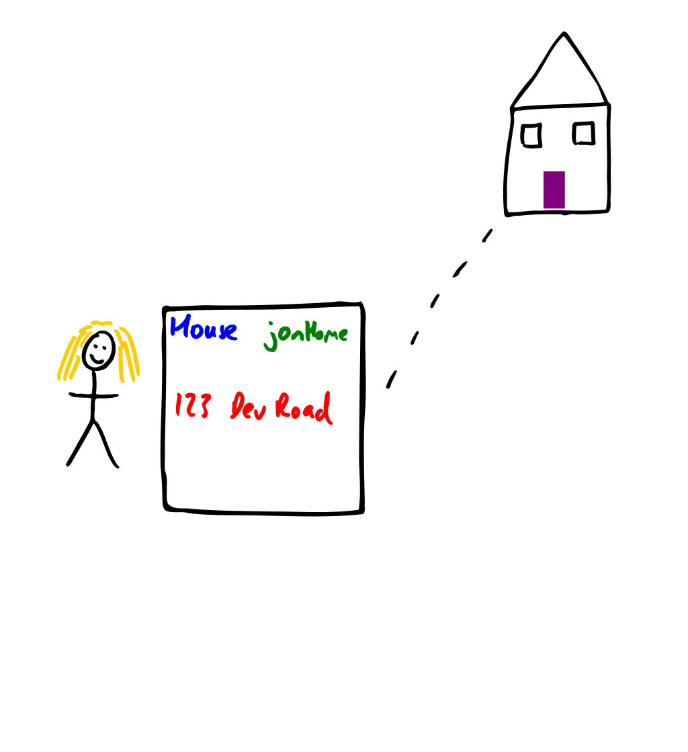
Notes:
Cori decides to pain Jon’s front door purple – she uses the piece of paper for navigation, and paints the door she finds in purple.

Slide 12
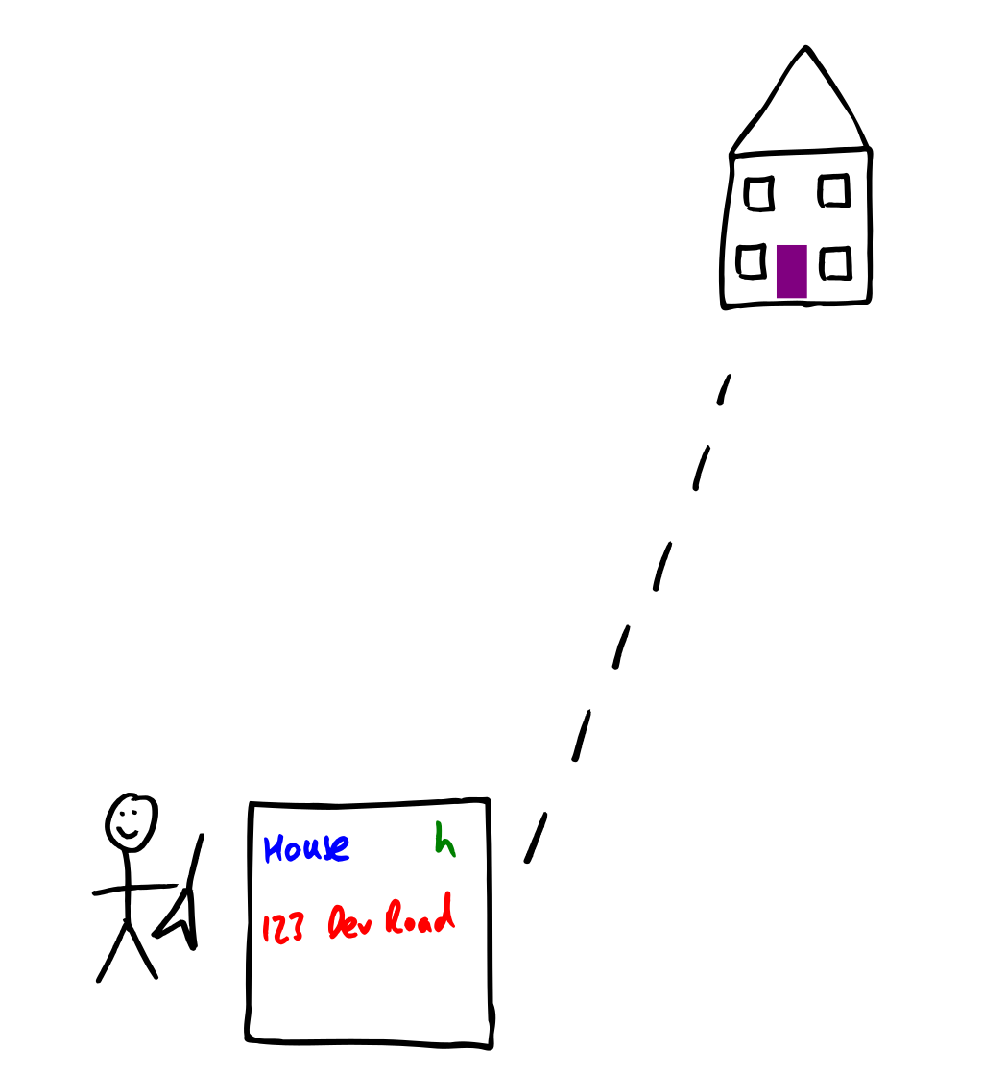
Notes:
Dustin visits the house (by finding the address on his piece of paper) and sees a purple front door.
Dustin works for Microsoft, so he likes Windows. He adds two windows to the house.

Slide 13
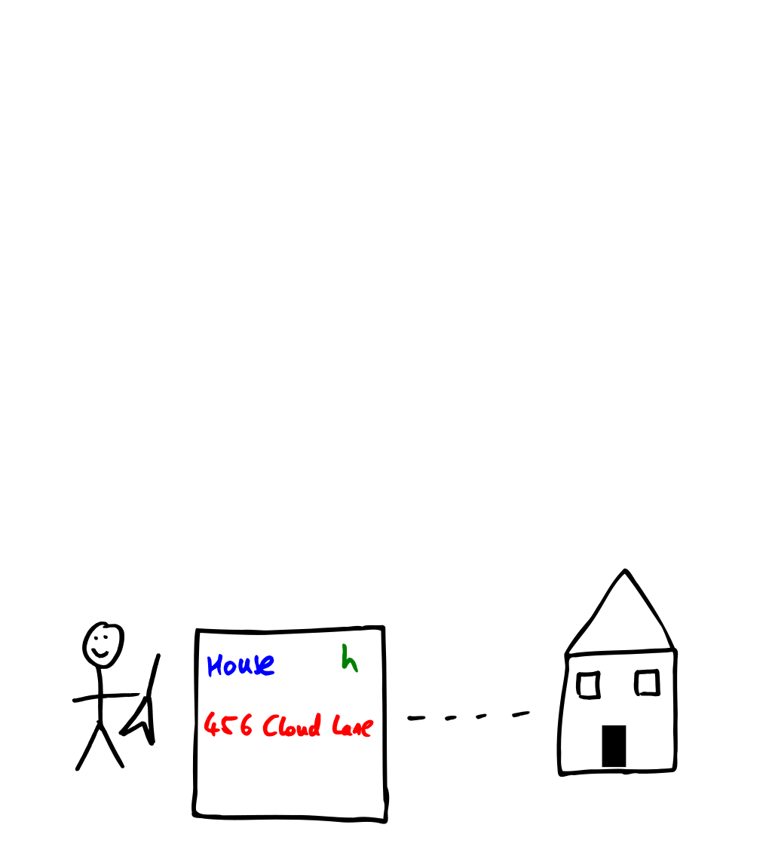
Notes:
Dustin then rubs out the address that was on the piece of paper, and writes down a different address
Instead, to a house with a black front door and two windows.

Slide 14
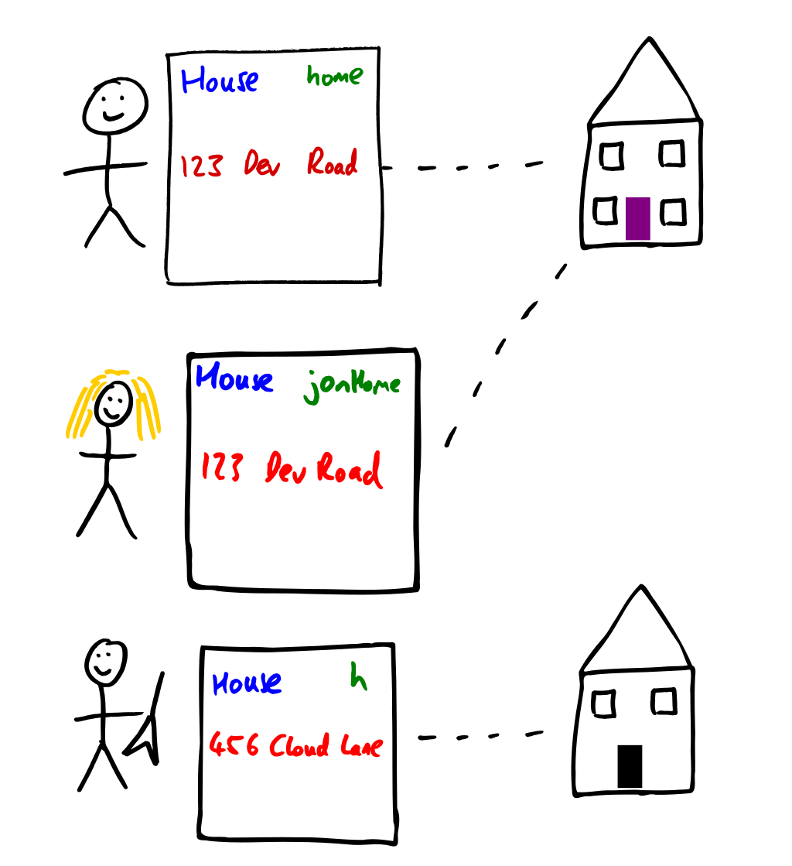
Notes:
So, now:
Jon and Cori have two pieces of paper with the same address on
Dustin has a piece of paper with a different address on

Slide 15
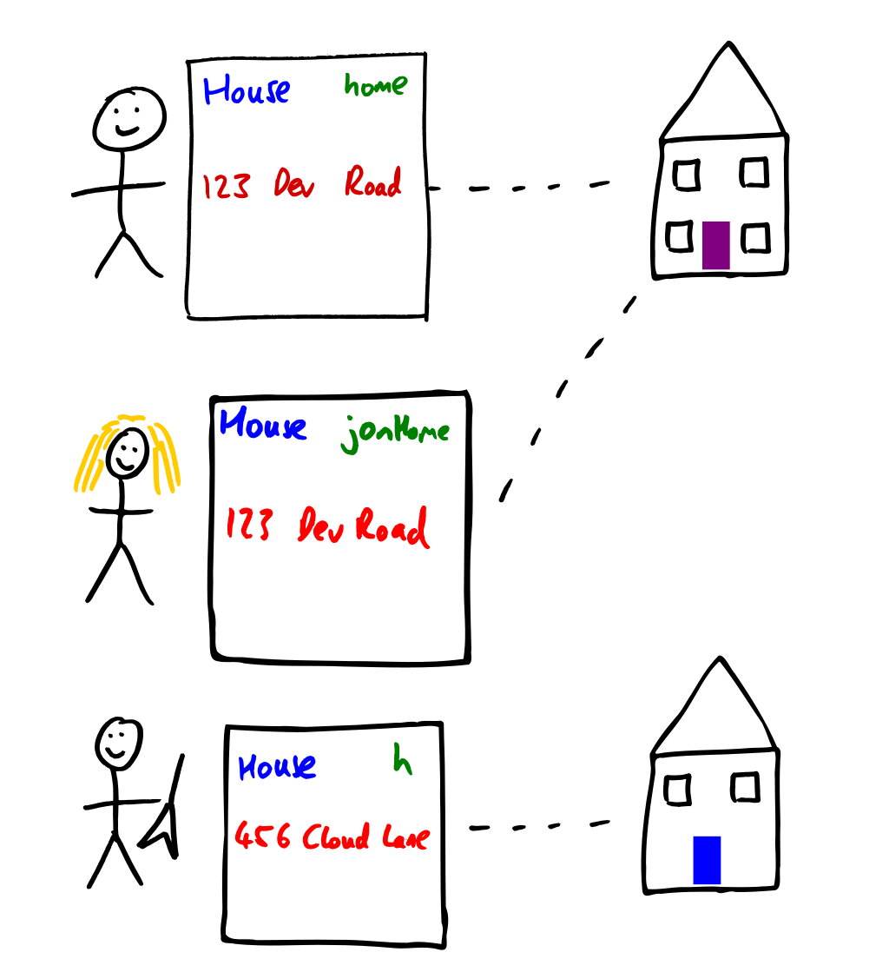
Notes:
Dustin goes to the address on his piece of paper, and paints the front door blue.

Slide 16
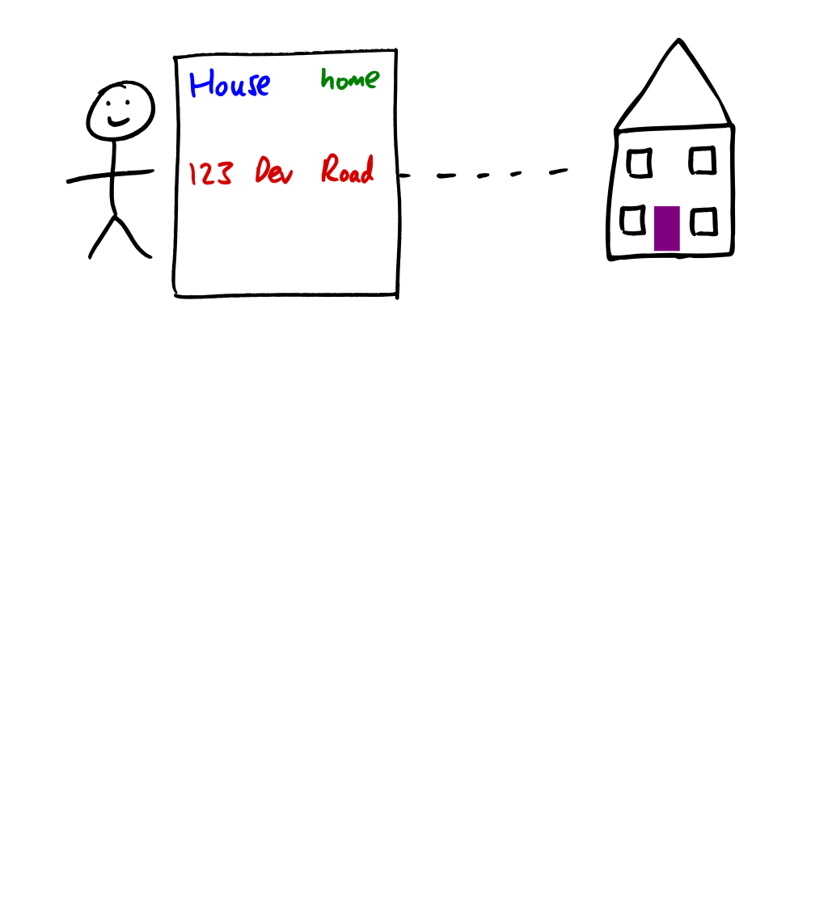
Notes:
When Jon goes home, his front door is still purple.

Slide 17
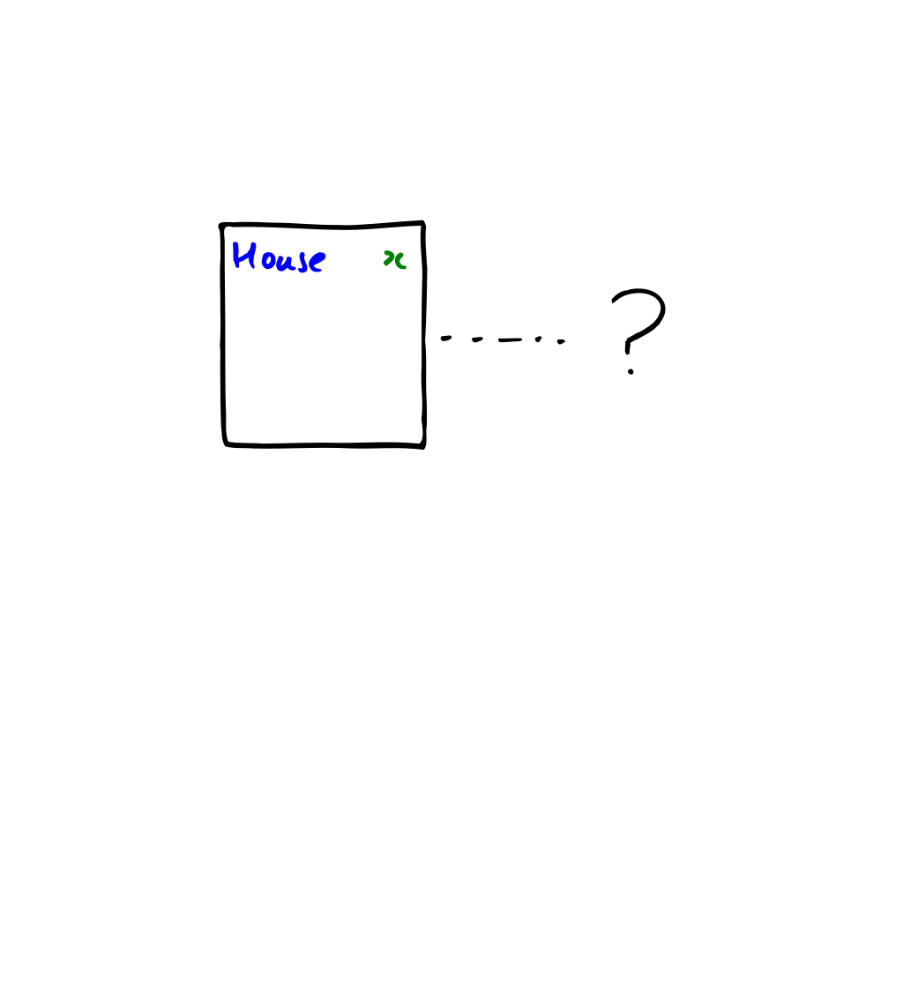
Notes:
For nullable types, we can have a piece of paper which is blank where the value would be.
That would be equivalent to a null value.
If we try to navigate using the piece of paper, we don’t have anywhere to go – so we get a NullReferenceException.

Slide 18
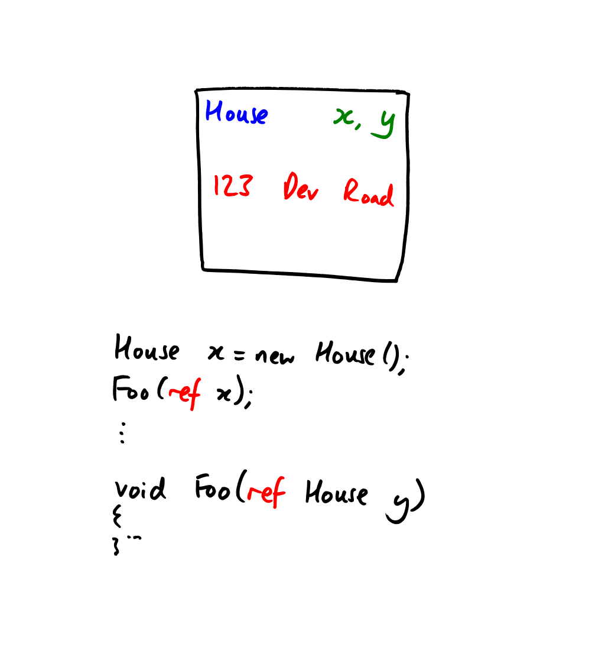
Notes:
This model can help explain ref parameters in C# too.
When we use ref parameters, there are multiple variables with the same storage location…
This is reasonably easily modelled as a single piece of paper with multiple names written on it.
When the method call returns, the “y” is erased.

Slide 19
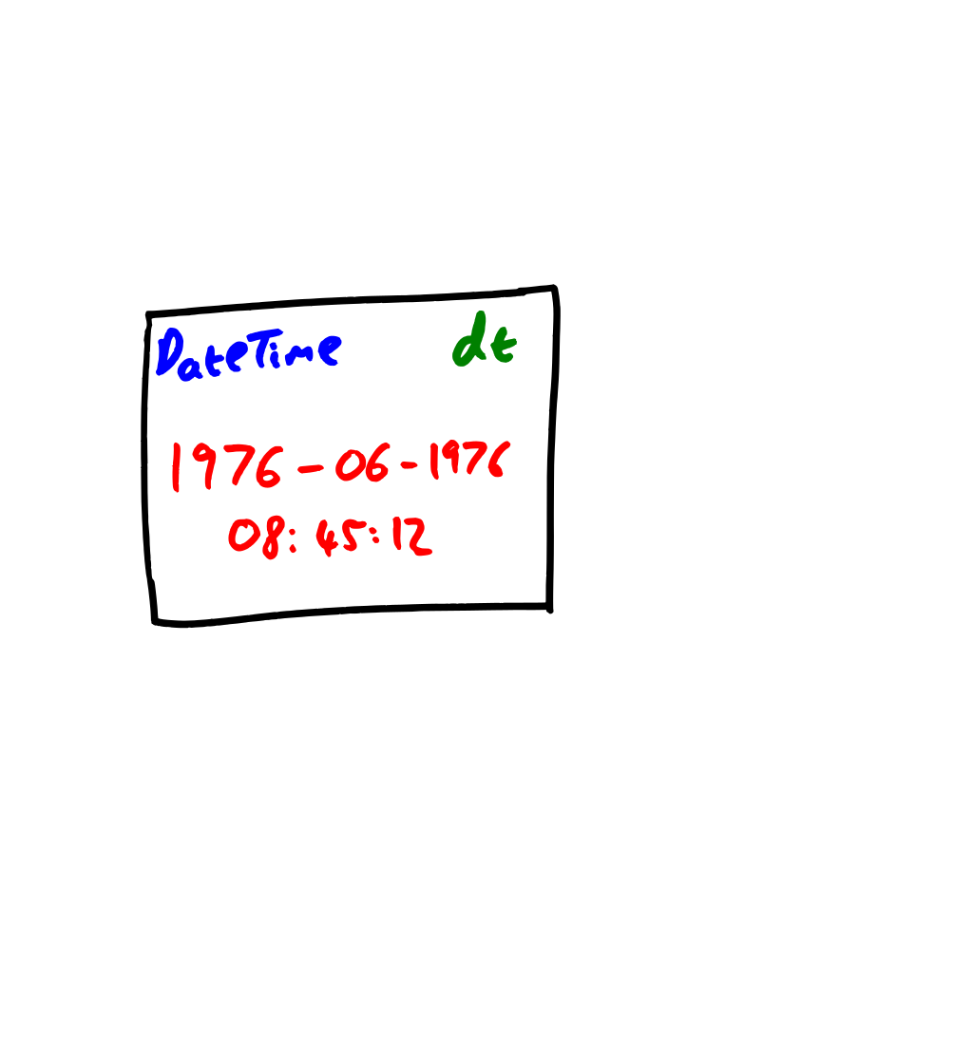
Notes:
You can model value types this way as well… now instead of having a reference to an object, all the information
In a value is written directly on the piece of paper.
Word of warning: do *not* write strings on pieces of paper, tempting as that sounds. Strings are objects.

Slide 20
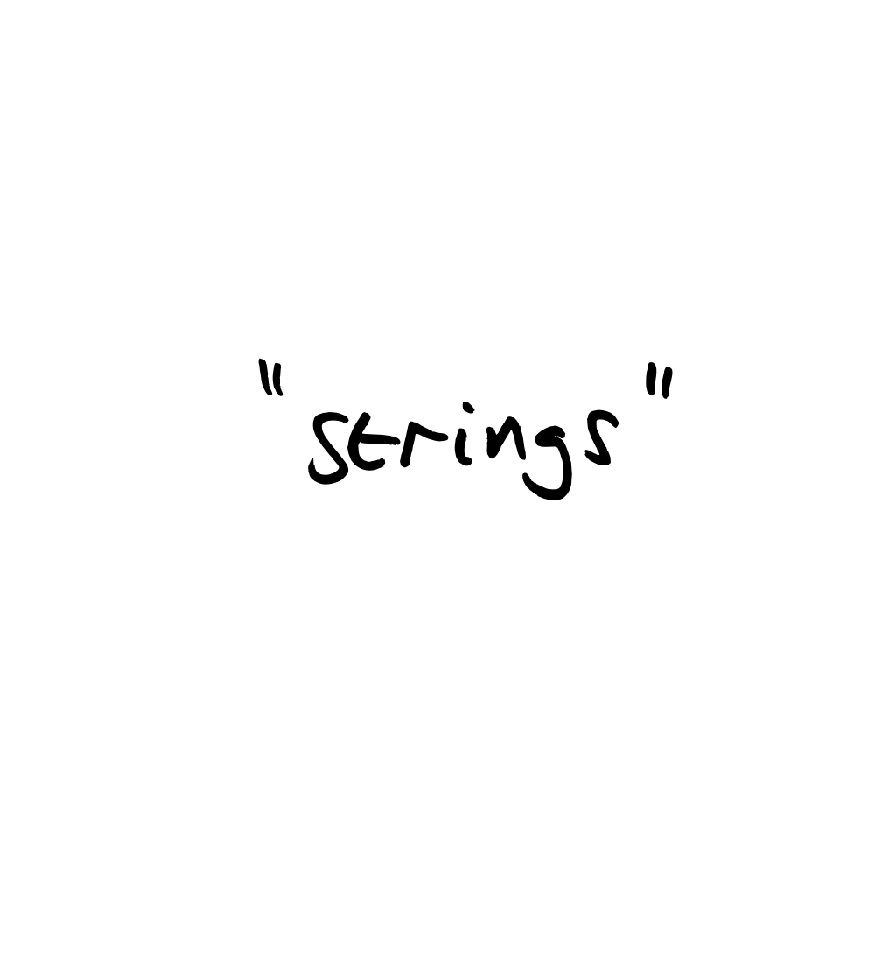
Notes:
Speaking of strings, let’s look at some of the common misconceptions around them.
Before we start, a few things I suggest you *don’t* get into to start with:
Surrogate pairs
Combining characters
Normalization forms
But we will talk about an abstract mental model, and encodings

Slide 21
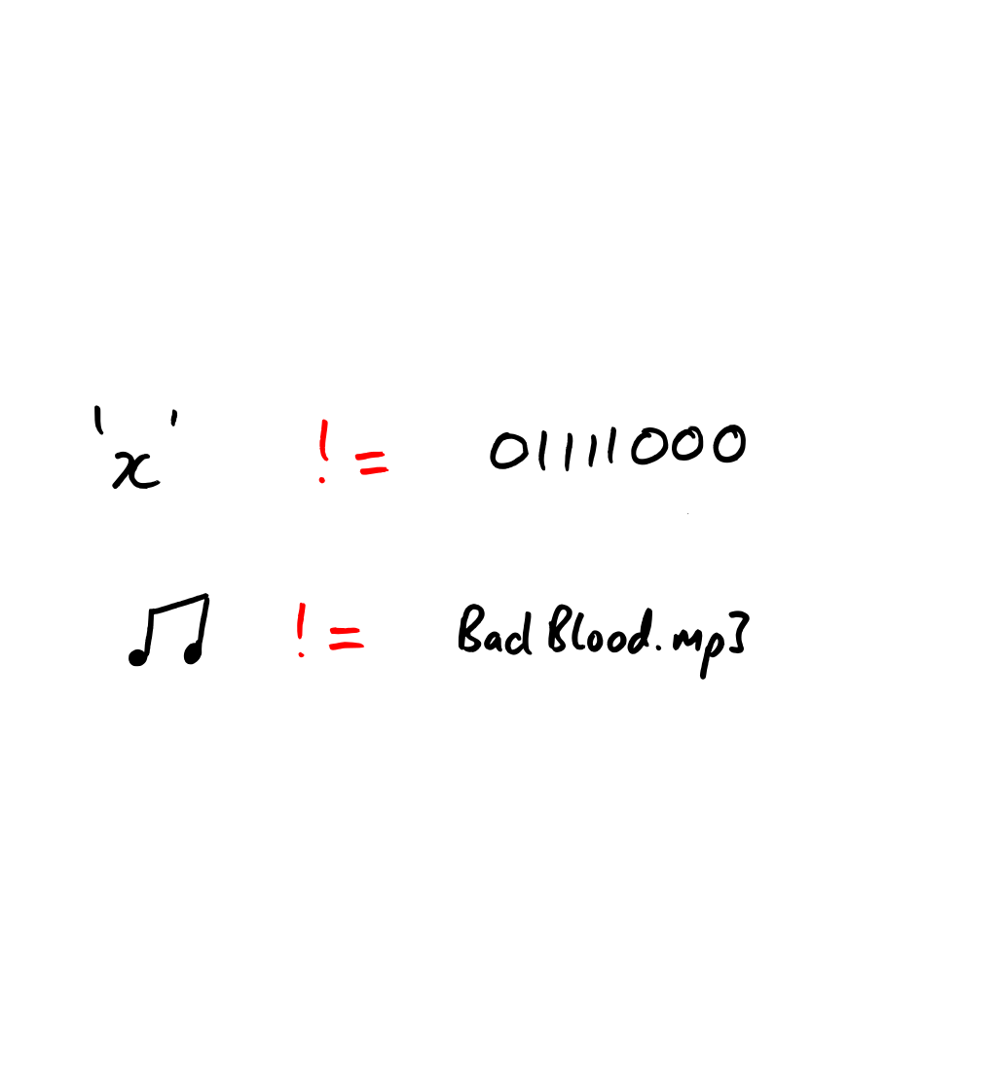
Notes:
A character is not a byte or a number. Sort of. Accept that there are times we see numbers.

Slide 22
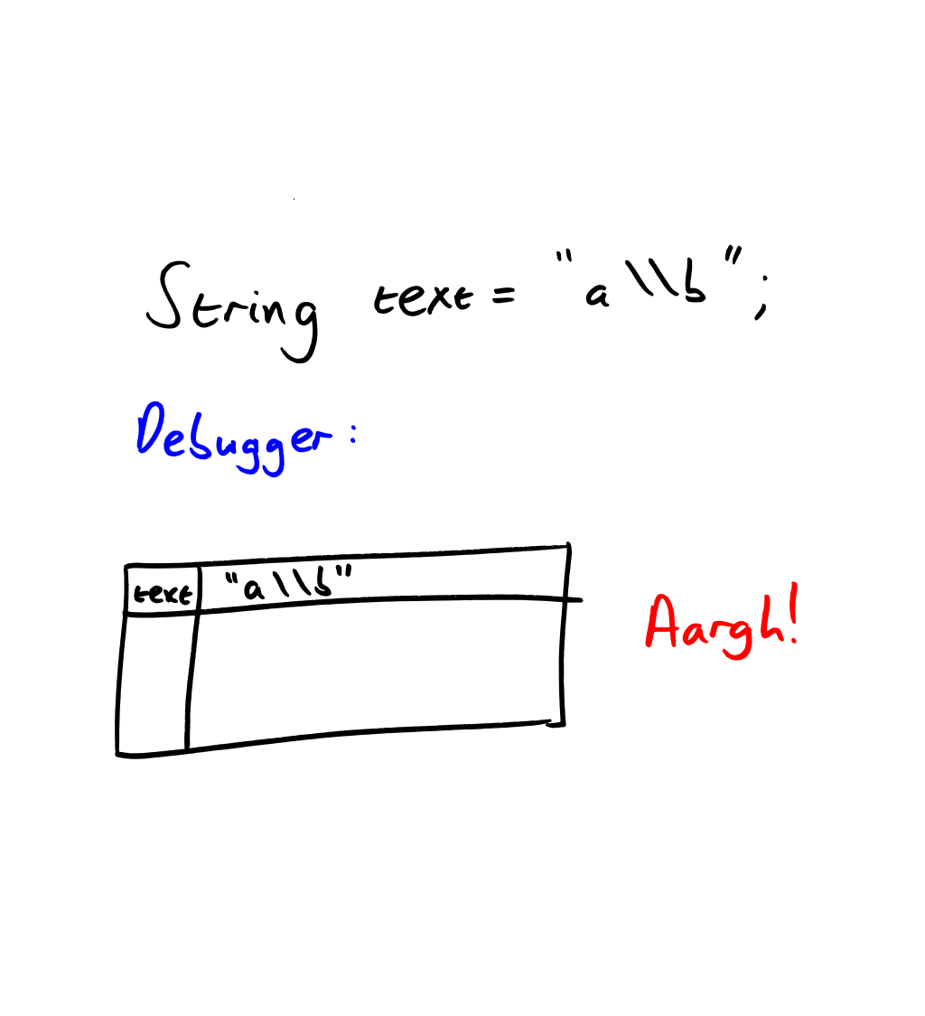
Notes:
Pitfall: the string in source code isn’t the same as the string you get, necessarily…
… and the debugger can be unhelpful here.

Slide 23
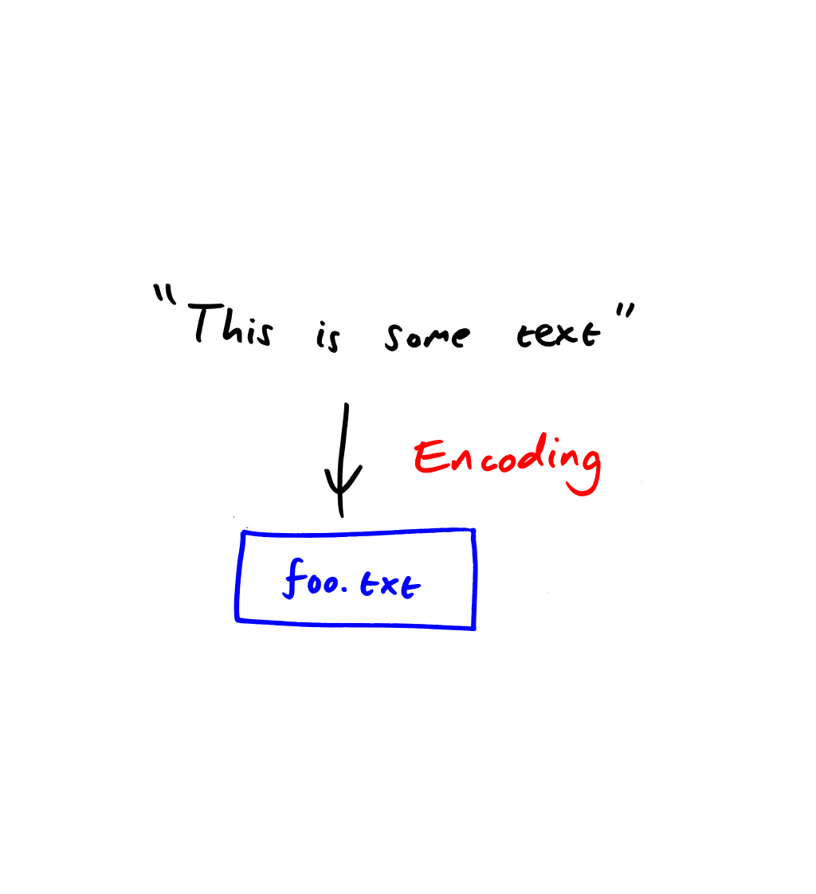
Notes:
So, if text isn’t the same as any particular bytes, how do we get a text file on disk?
We need an encoding – just like music needs encoding.
The encoding you use determines what bytes end up on disk.
Unfortunately, a lot of encodings look similar – there isn’t (typically) a magic number like there is at the start of an image or sound file.

Slide 24
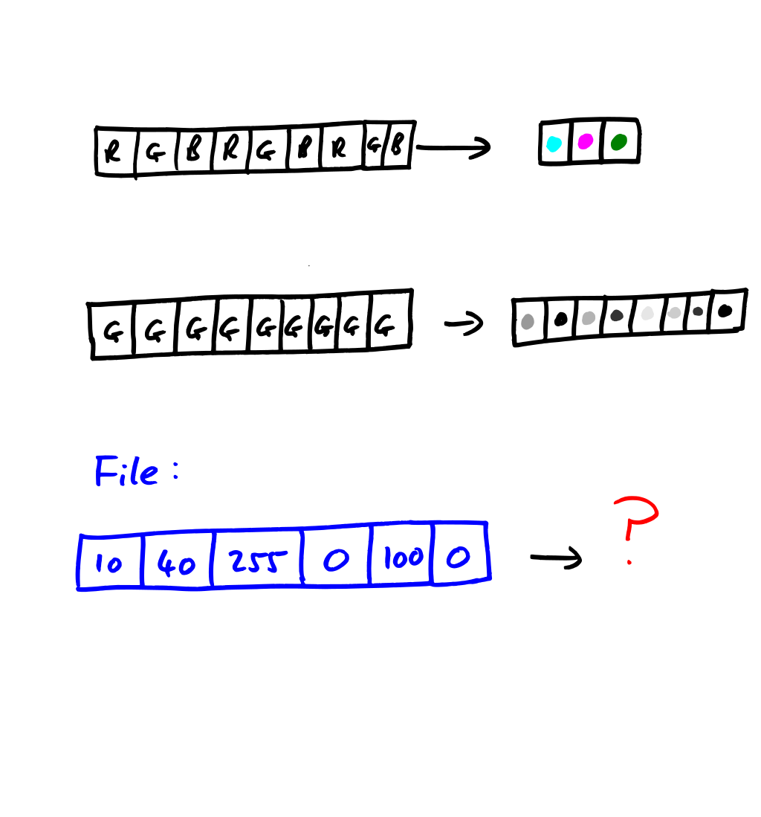
Notes:
So what happens if you use the wrong encoding? It’s probably easiest to picture that using image formats.
Imagine two raw image formats, one greyscale and one RGB.
No magic number.
No size information.
How do you load the file?
You might be able to detect it from the file size – if it’s divisible by 3 – but you may not.
When you think about text encodings, imagine them as being like these raw image formats.

Slide 25
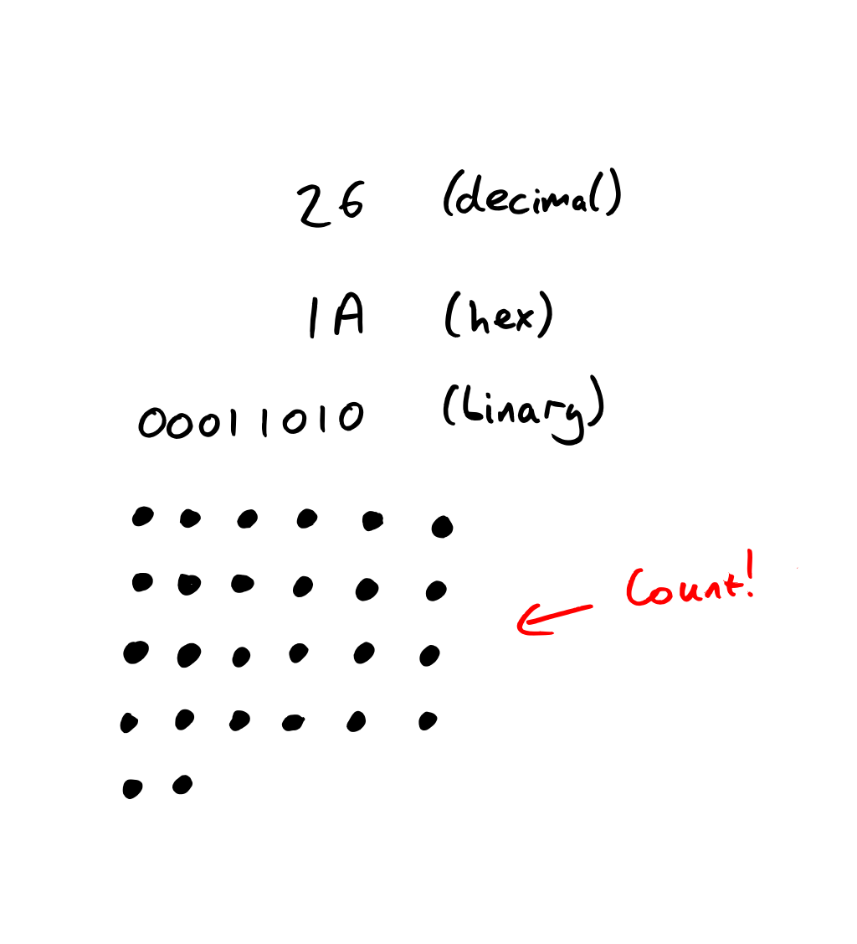
Notes:
Integers. Next data type.
Relatively simple… but still misunderstood.
Again, separate the value from a representation:
Text representation
Even binary representation (the type of the value)
No such thing as “an int in hex”
After understanding pure integers, put that into the context of specific types – determines the values that can be represented.
Normally bit patterns don’t matter – unless you’re using bit twiddling operators.
To reason about things, use 8 or even 4 bits.

Slide 26
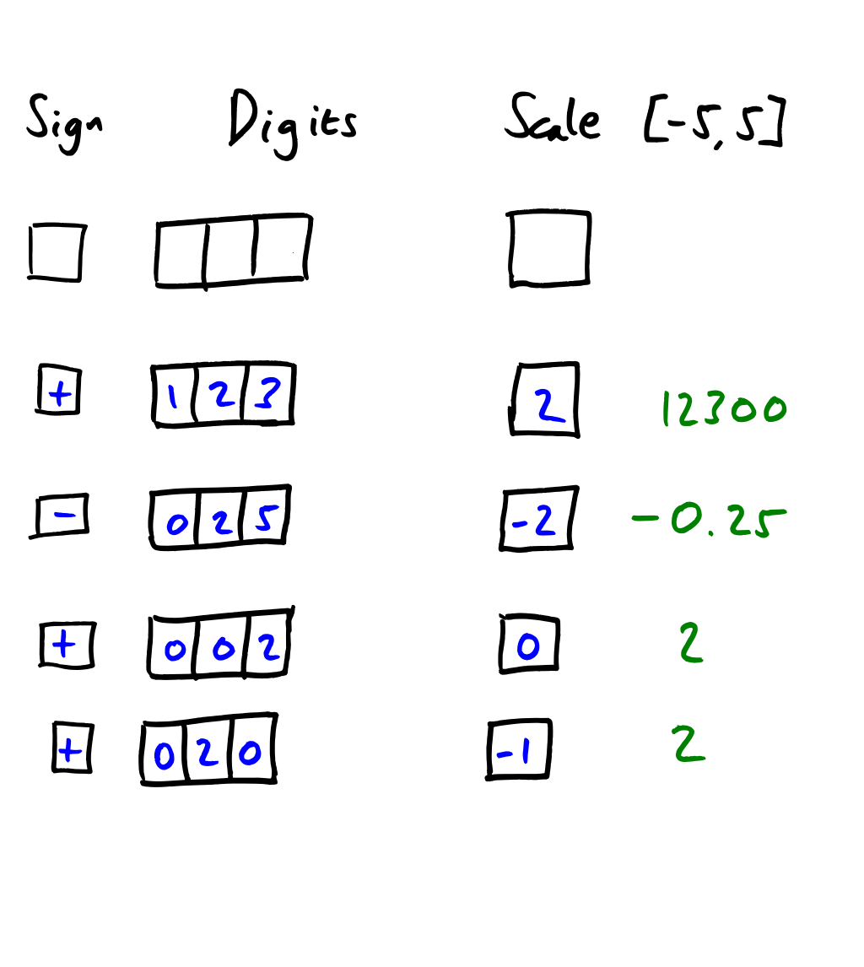
Notes:
Floating point is even more misunderstood.
Still just numbers really (at least mostly) – but again, the format you use determines which values can be represented.
Myth: “floating point numbers are inaccurate”
Give examples using a made up type
A sign, 3 digits, and a scale of -5 to 5 (inclusive)
Can change this if you want – could be useful

Slide 27
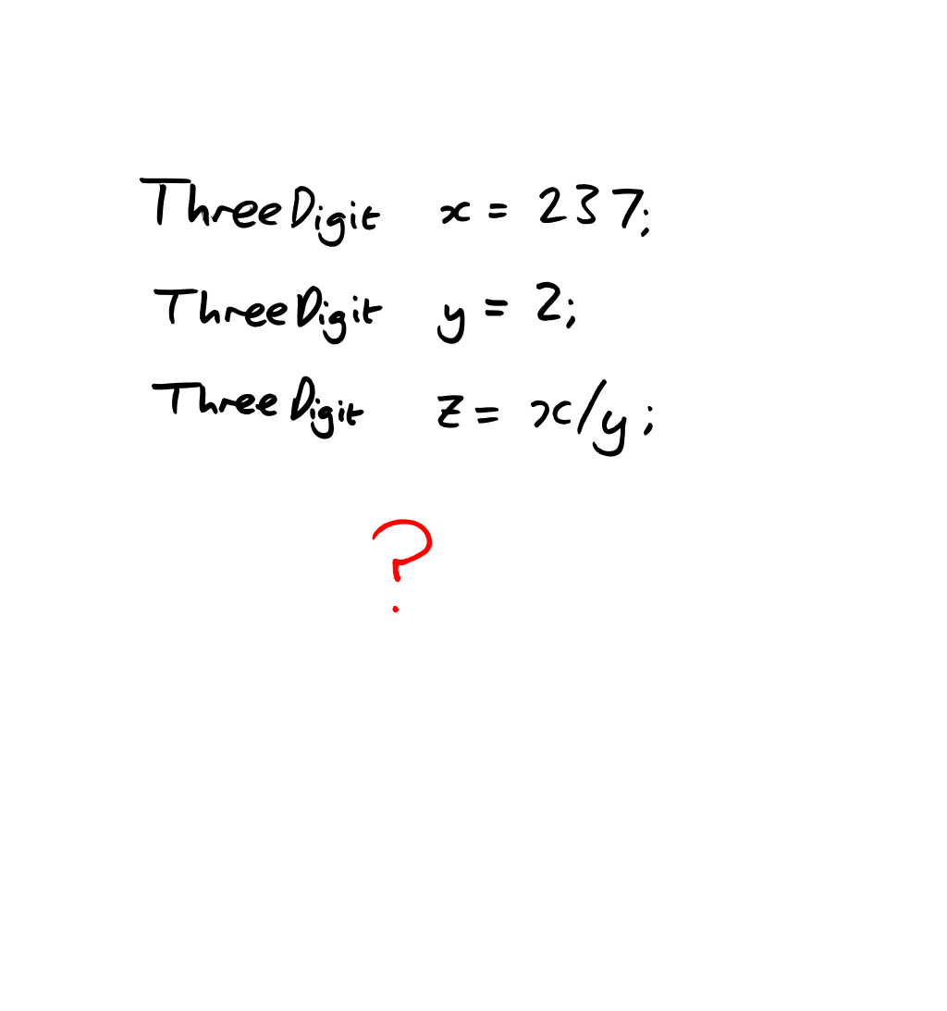
Notes:
What is 237 / 2 in this context?
“Theoretical” answer: 118.5
So represent as 118
The 118 is still exact

Slide 28
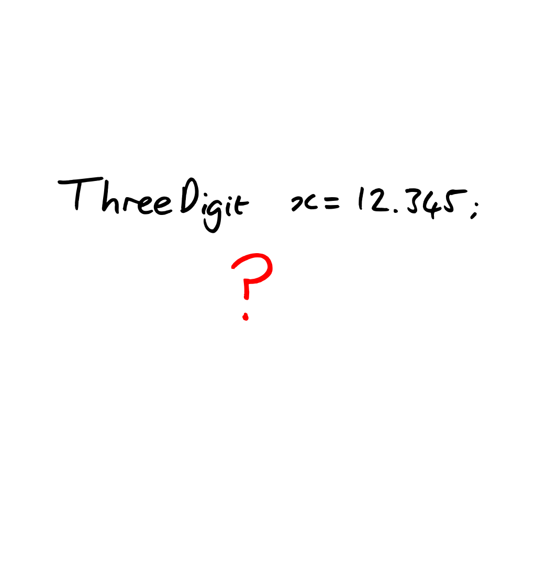
Notes:
What is the value of this literal?
At execution-time, just 12.3… exactly.
Operation loses information, not the value itself.
Can think of a value as a range of numbers, but gets complicated.

Slide 29
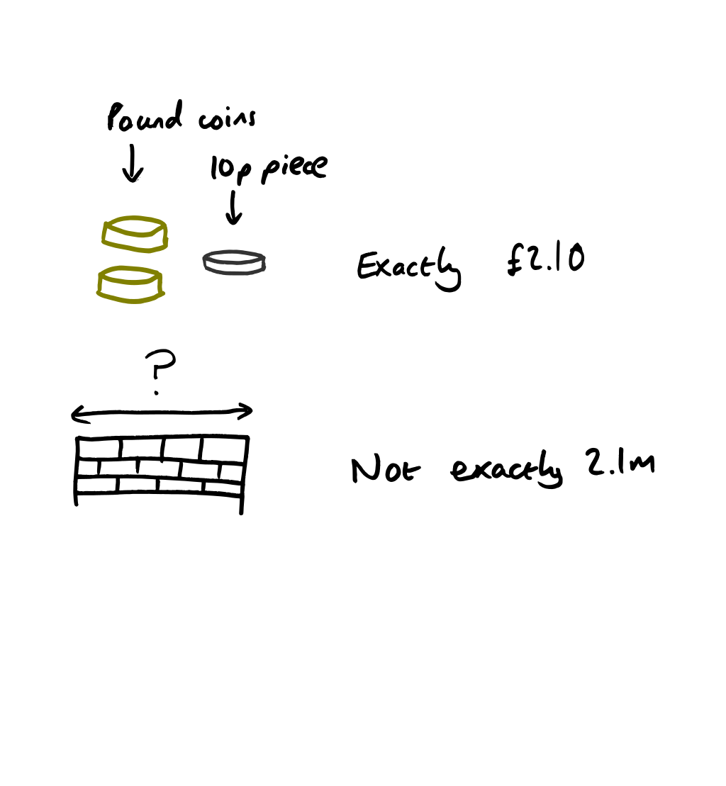
Notes:
That’s floating point in general.
Now you can confuse people a little by talking about binary floating point instead.
Typically people don’t “get” binary floating point as easily, but show comparisons
When do you use which?
Artificial vs natural
Discrete vs continuous
Nature tends to do “integers” and “continuous values” – not “discrete non-integers”
Almost canonical example: currency

Slide 30

Notes:
Dates and times! Not going to say much about it, for once.

Slide 31
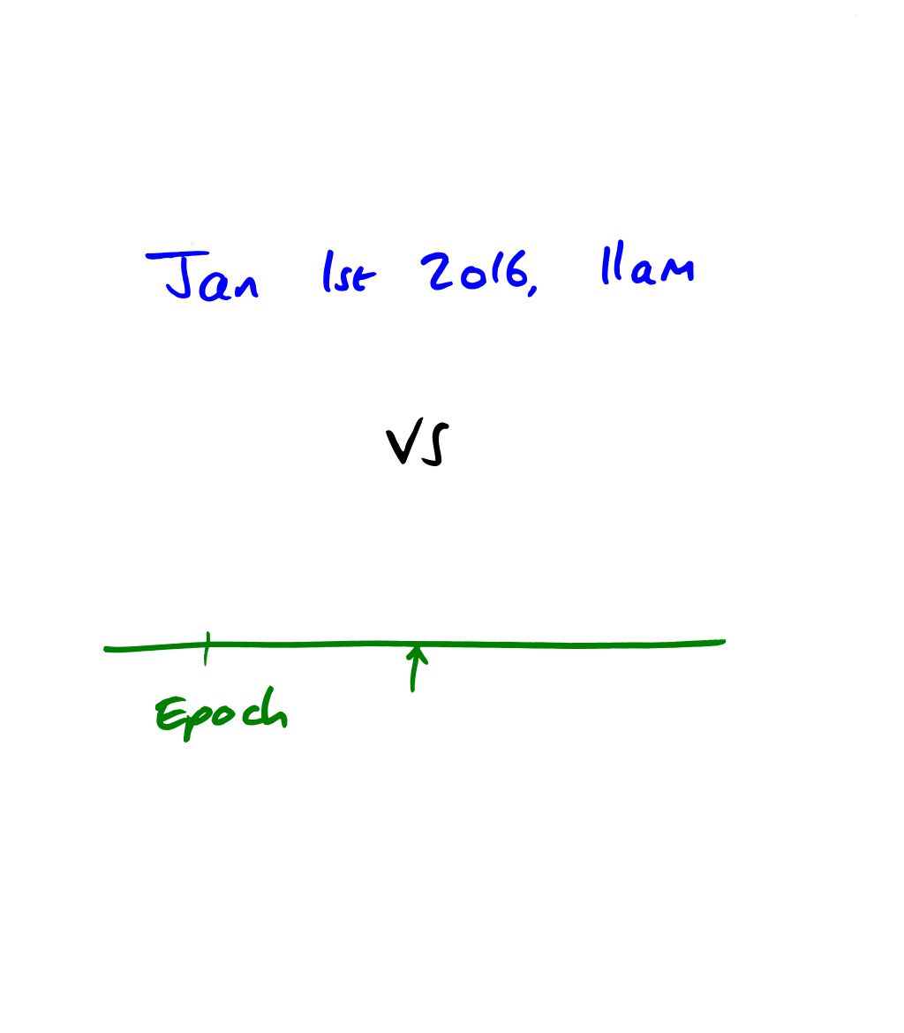
Notes:
Discrete and continuous, artificial and natural
Human-specified dates/times vs timestamps
Adding a month to a timestamp makes no sense
Adding a given number of milliseconds to a human-specified date/time probably doesn’t either

Slide 32
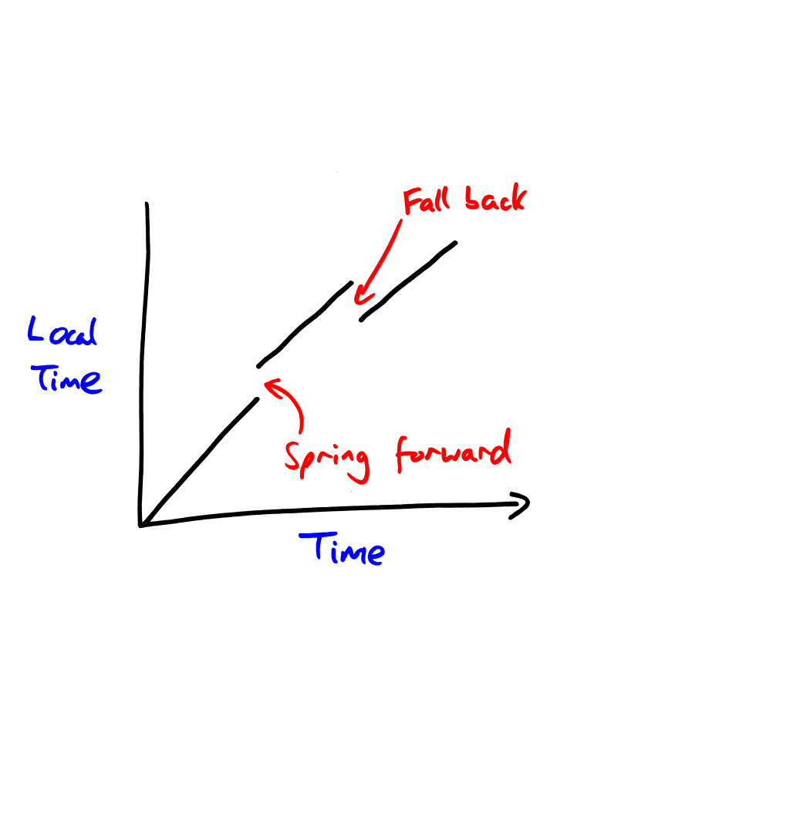
Notes:
Time zones – complicated or not?
Function between continuous time and a local representation.
Slow down, write tests, don’t make assumptions.
Test time zones with DST change at midnight
Test time zones with a non-single-hour DST change
Think about what happens if a time happens twice or is skipped
Think of concrete examples – meetings, birthdays, timestamps etc
Use a decent library – Noda Time ☺

Slide 33
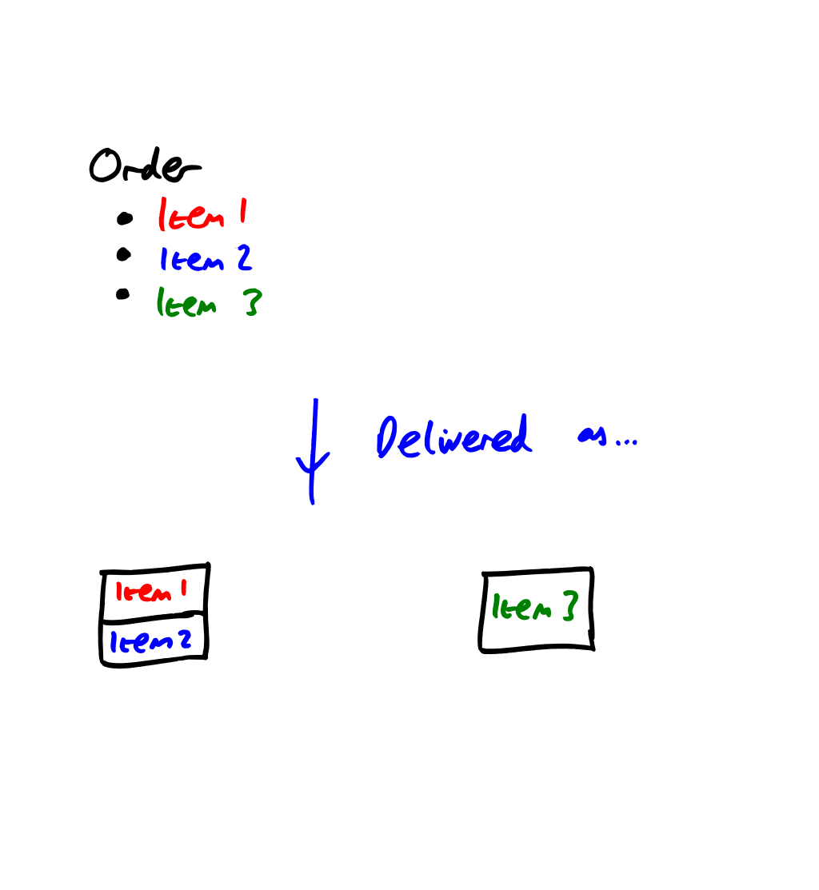
Notes:
Streams of data… two problems we’re going to look at, where expectations are violated.
Read operation not returning as much data as you expect
Read operation not returning precisely the amount of data sent
Again, go to real world examples rather than sticking to “reading from a socket” where abstractions can distract
Amazon order of three items – “receive” call might give you everything back, or just a bit at a time
If you didn’t know what was in the order, how would you know when everything was delivered?

Slide 34
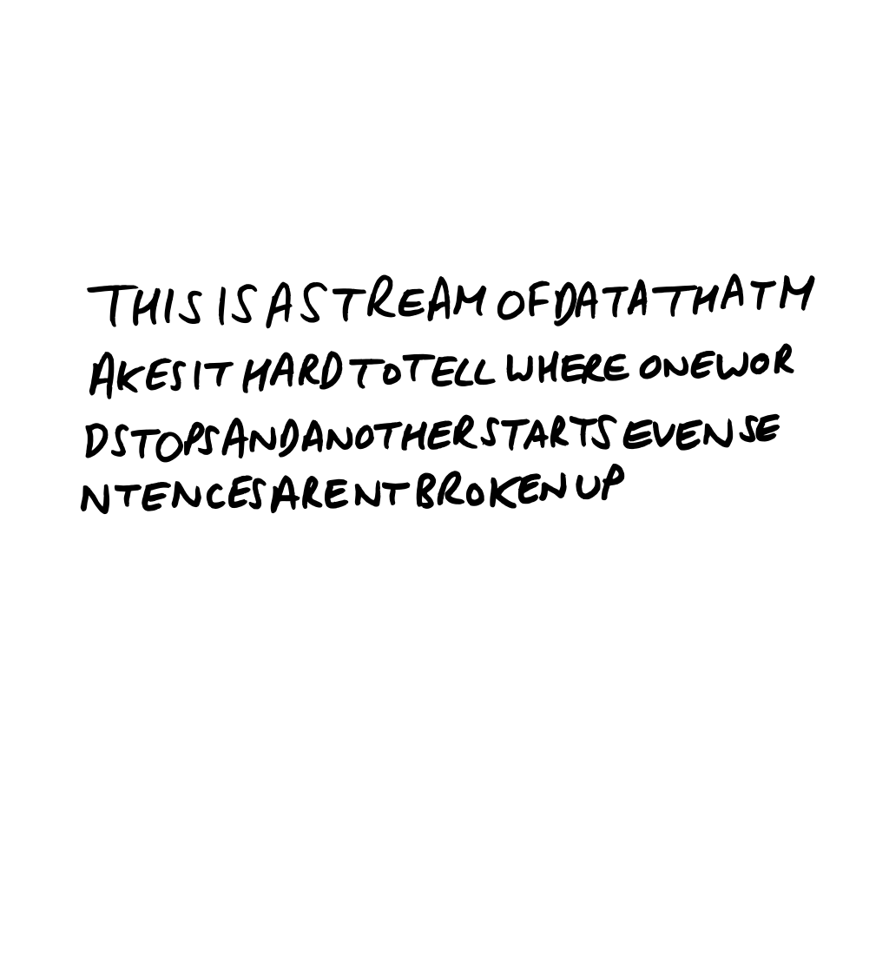
Notes:
Message chunking – how can you split this into words and sentences?
Streams are like this.
Spaces and full stops provide one obvious way of handling things…
… but they complicate things with abbreviations etc.

Slide 35
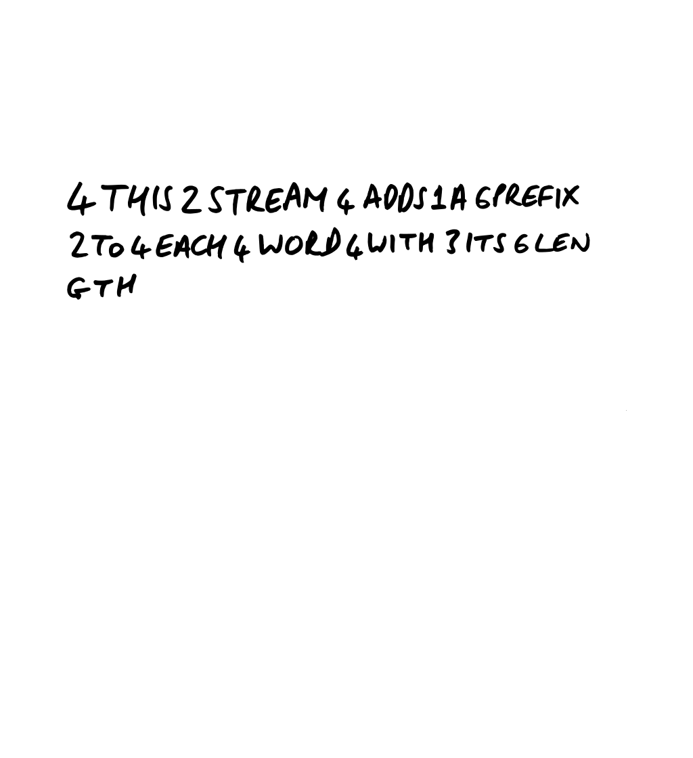
6
Notes:
In computing, prefixes work better.
When you can count, anyway – as I failed to with the second word here…

Slide 36
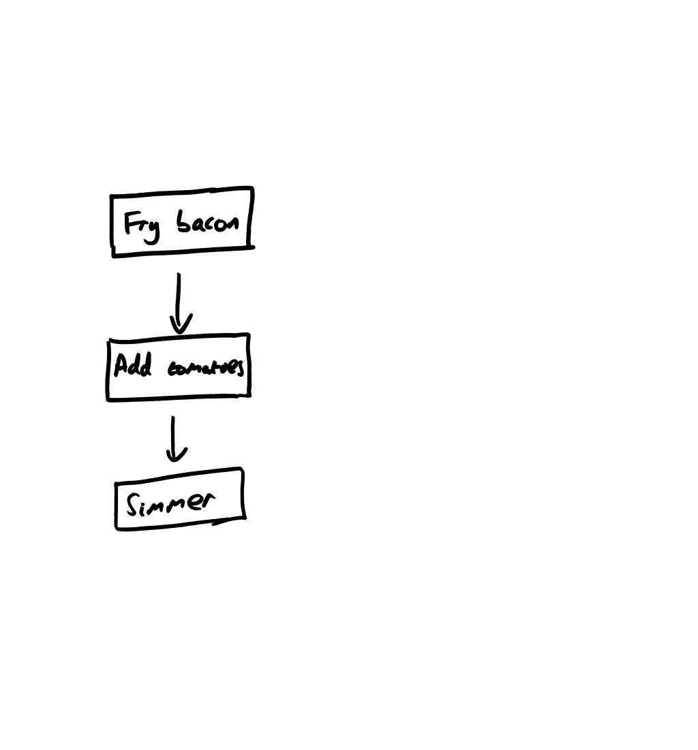
Notes:
Parallelism and asynchrony.
Differentiate between them with examples.
But be careful – modelling threads can be tricky.
I tend to think of a thread as a person who can do stuff.
First let’s look at two kinds of parallelism, by cooking some soup.
In order to make my soup, I fry some bacon in a frying pan, transfer it to a saucepan, add some tomatoes, and simmer.
For the purposes of this example, let’s assume that a person needs to be constantly attending it – moving the bacon around or stirring the mixture, for example.

Slide 37
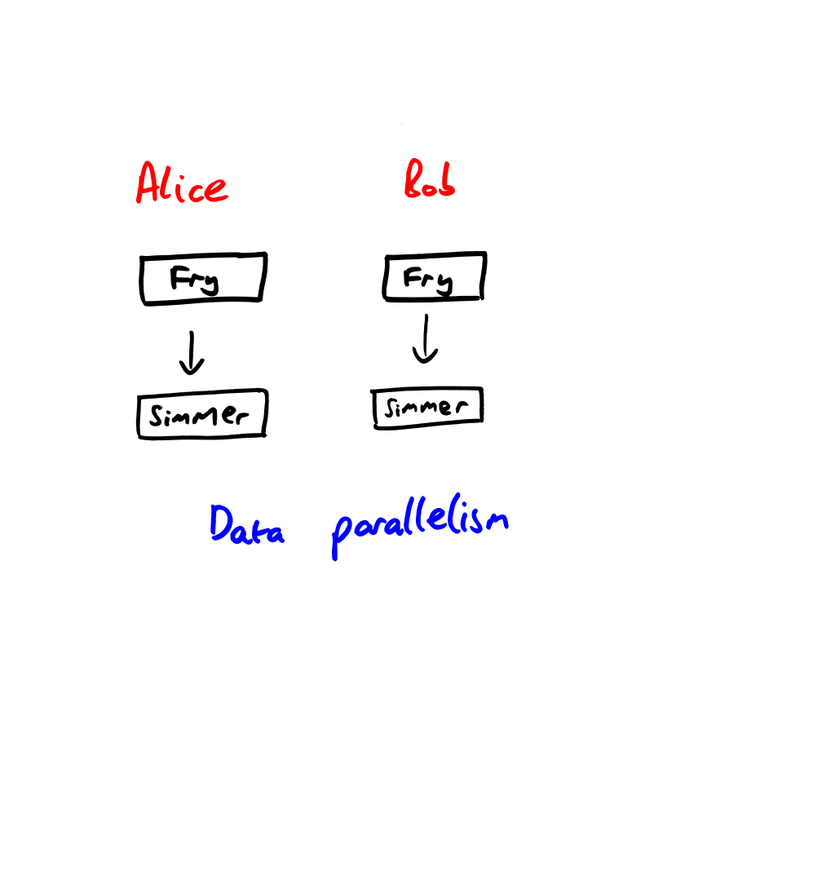
Notes:
So I start my soup shop, and find that I actually sell more than I can make with just one person.
I need two people to be working.
I can parallelize their work in two different ways.
Data parallelization says, “each of Alice and Bob should take half the ingredients, and each of them makes complete soup from scratch.”
As an interesting aside, this requires 2 frying pans and 2 saucepans.

Slide 38
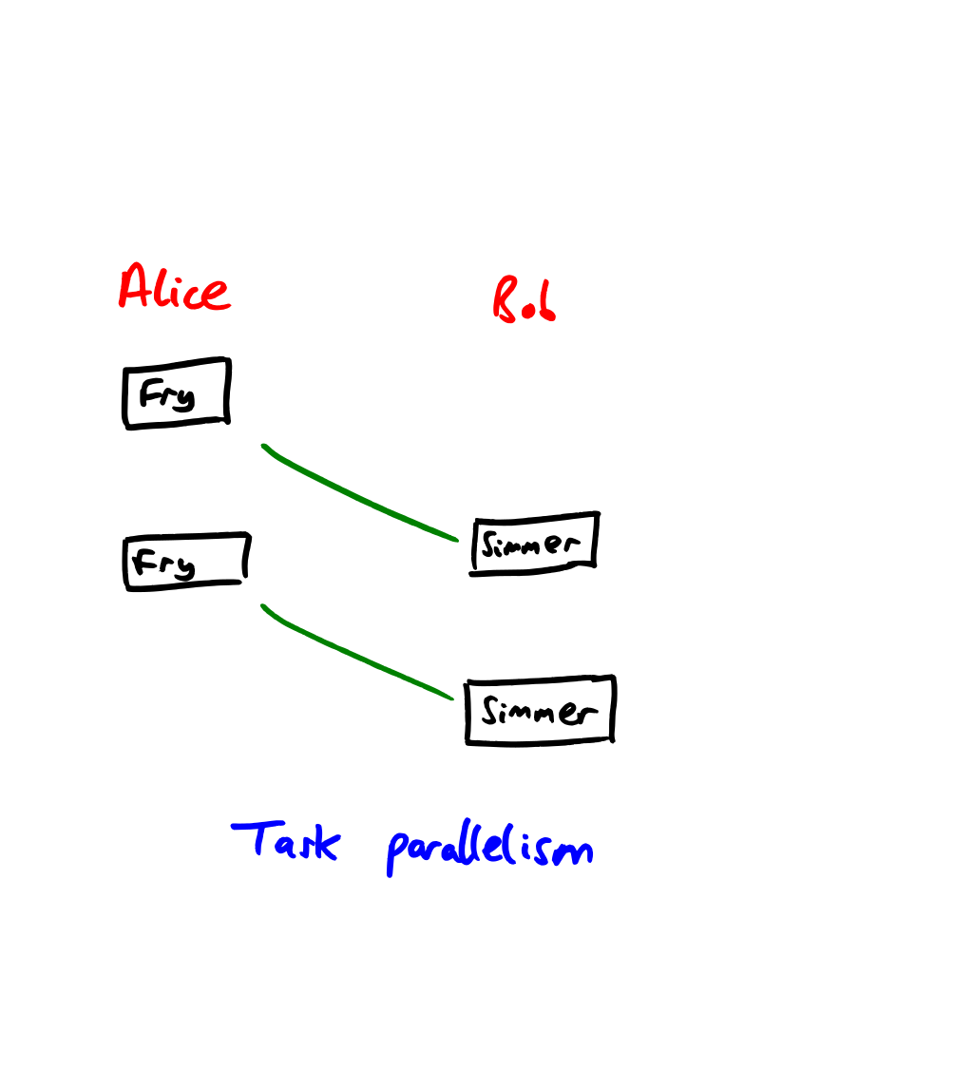
Notes:
With task parallelization, Alice does all the frying and Bob does all the simmering.
Each is a specialist in their own task.
We only need one frying pan and one saucepan – but we also need coordination between Alice and Bob.
Lead on to more discussions of:
What happens if frying bacon is quicker than simmering?
What happens if it’s the other way round?
Can we add data parallelism as well?

Slide 39
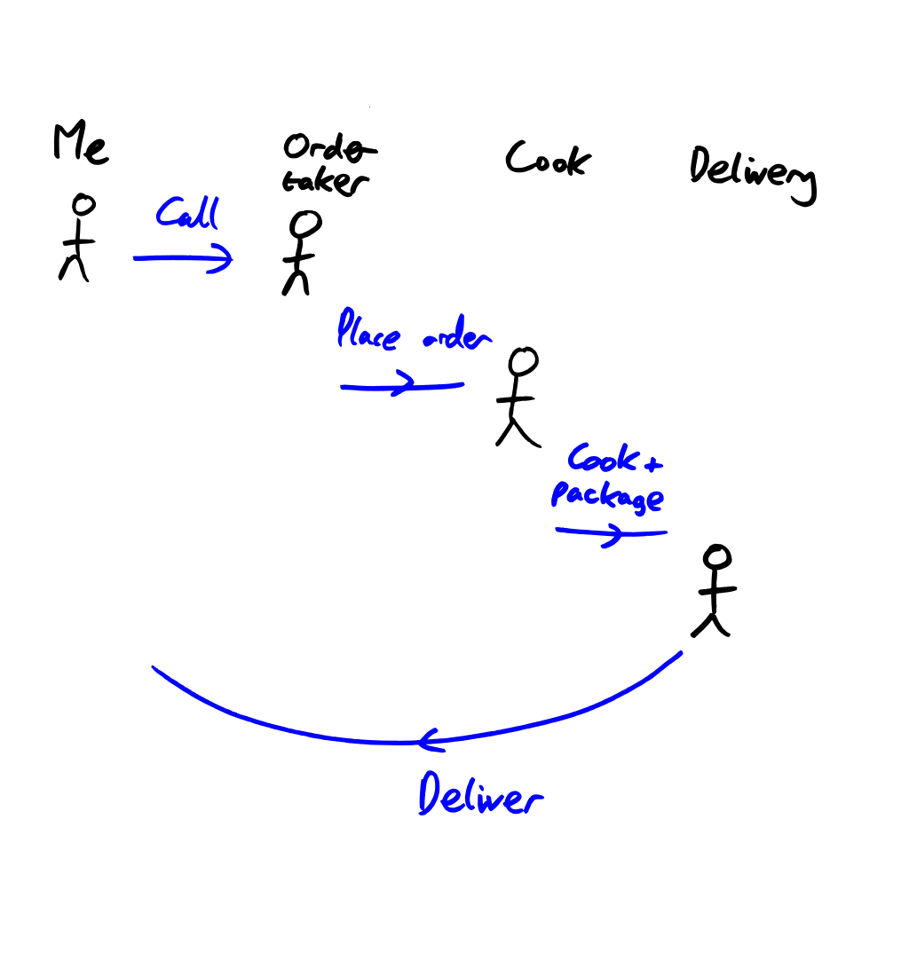
Notes:
Synchronous operation:
Call pizza place
Wait on doorstep for pizza to arrive
Asynchronous operation:
Call pizza place
Watch TV, post to Stack Overflow, play games…
When the pizza arrives, doorbell acts as a notification to pick up the pizza

Slide 40
And much more…
SQL injection
Randomness
Much more date/time
Diagnosing data transport issues
Captured variables in C#
… the list goes on

Slide 41
Questions?

